Slide 1


Slide 2
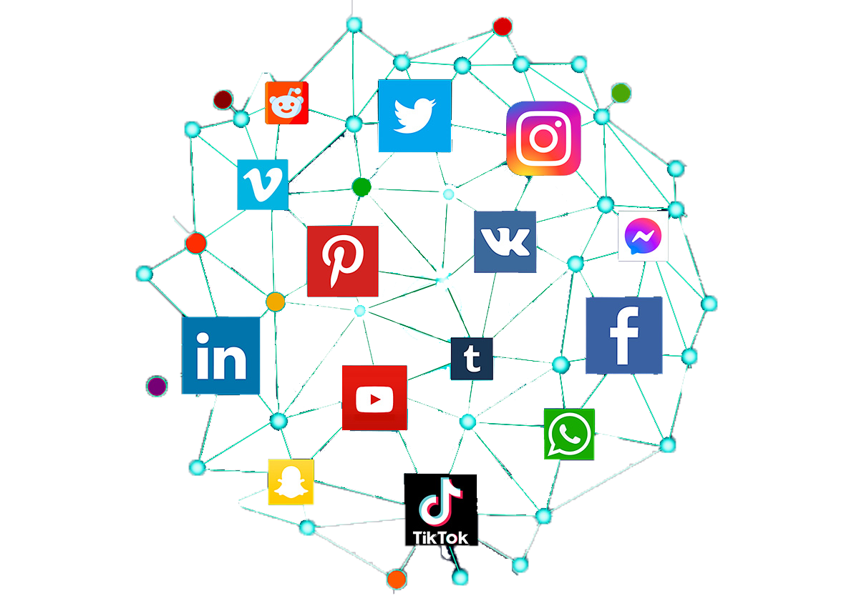
Social Media Marketing

Slide 3
Social media marketing is the use of social media platforms to promote products or services, engage with customers, and build brand awareness
What is Social Media Marketing?
Definition
Goals
Increase brand visibility
Drive website traffic
Generate leads

Slide 4
Importance of Social Media Marketing
Wide Reach
Billions of users across various platforms provide vast opportunities for engagement
Targeted Advertising
Advanced targeting options allow marketers to reach specific demographics
Customer Engagement
Direct interaction with customers fosters relationships and brand loyalty
Real-Time Feedback
Instant feedback and insights can guide marketing strategies

Slide 5
Overview of Major Social Media Platforms
Facebook
Largest user base, versatile for various content types (text, images, video)
Instagram
Visual-focused platform ideal for branding and storytelling through images and videos
Twitter
Real-time engagement, great for news and updates, limited to short text posts
LinkedIn
Professional networking site, effective for B2B marketing and industry insights
TikTok
Short-form video platform, popular for creative content and younger audiences

Slide 6
Creating a Social Media Strategy
Key Steps
Define goals
What do you want to achieve? (e.g., brand awareness, lead generation)
Know Your Audience
Identify demographics, interests, and behaviors
Choose Platforms
Select the most relevant platforms for your audience and goals
Content Planning
Determine types of content to create and share

Slide 7
Organic vs. Paid Content
Organic Content
Unpaid posts that engage audiences through regular updates and interaction
Benefits
Builds community, enhances brand loyalty, and is cost-effective
Paid Content
Sponsored posts or ads that reach a broader audience
Benefits
Immediate visibility, precise targeting, measurable results

Slide 8
Key Elements of a Successful Social Media Campaign
Compelling Content
Create engaging, shareable content that resonates with your audience
Consistency
Regular posting schedule to maintain engagement
Use of Hashtags
Increase discoverability and reach on platforms like Instagram and Twitter
Engagement
Respond to comments, messages, and mentions to foster relationships

Slide 9
Measuring Success in Social Media Marketing
Key Metrics
Engagement Rate
Likes, comments, shares, and interactions
Reach and Impressions
Number of people who see your content
Follower Growth
Increase in followers over time
Conversions
Actions taken as a result of social media campaigns (e.g., website visits, sales)

Slide 10
Social Media Marketing Best Practices
Stay Authentic
Be genuine and transparent in your messaging
Utilize Visuals
High-quality images and videos capture attention more effectively
Monitor Trends
Stay updated on platform changes and industry trends
A/B Testing
Experiment with different content types and strategies to see what works best

Slide 11
Discussion Questions
Which social media platform do you find most effective for marketing and why?
(Encourage students to reflect on platforms they prefer)
Can you share an example of a brand that uses social media well? What do they do right?
(Encourage discussion of successful social media campaigns)

Slide 12


Slide 13


